Slide 1

Data Analysis
Alex Henderson University of Manchester http://about.me/henderson.alex

Slide 2
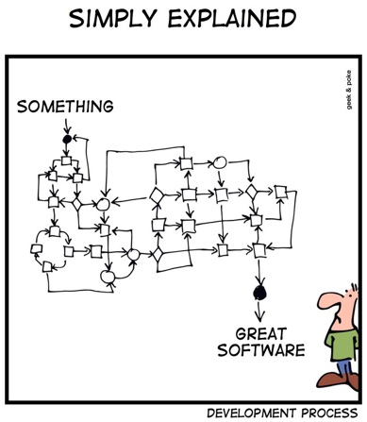
My remit…
Result!

Slide 3

Statistics…

Slide 4
Download MATLAB Code
Open a Command Prompt and enter the following
mkdir C:\CLIRSPEC
cd C:\CLIRSPEC
git clone http://bitbucket.org/AlexHenderson/chitoolbox.git
(Last part all on one line)

Slide 5
In MATLAB…
In Command Window enter
cd(‘C:\CLIRSPEC\chitoolbox’);
ChiUpdate();

Slide 6
Load example data
load(‘data/utidata.mat’);
Real world…
ChiAgilentFile();
ChiRenishawFile();
ChiThermoFile();

Slide 7
Plot spectra
figure; data.plot();

Slide 8
Pre-processing
Three types:
Transformation
Data-space normalisation
Per-spectrum
Scaling
Statistical normalisation
Per-wavenumber
Centering
Pull data to origin of hyperspace
Per-wavenumber
Optional

Slide 9
Transformation
Options include:
Wavenumber scale
Interpolation (if different number of data points)
Peak selection
Intensity scale
Log transform (need to manage zero values)
Square root transform (also cubic or quartic)
Normalisation (sum of all counts, to a specific peak)

Slide 10
Scaling
Options include
Variance scaling
Autoscaling (variance scaling and mean centering)

Slide 11
Mean Centering
Subtract mean of each measurement (peak intensity)
Moves origin of hyperspace to centre of data

Slide 12
Vector normalisation
Euclidean distance
Group defined as ‘nearby’ points
Red outlier is a problem
Notes:
Draw lots of lines to origin. Recreate?

Slide 13
Vector normalisation
Each data point is a vector
Redefine the length of the vector to unity (1)
Notes:
Draw lots of lines to origin. Recreate?

Slide 14
Vector normalisation
datavn = ChiVectorNormalise(data);

Slide 15
Plot spectra
figure; datavn.plot();

Slide 16
PCA
pcaresult = data.pca();
figure; pcaresult.plotscores(1,2);

Slide 17
PCA
pcaresultvn = datavn.pca();
figure; pcaresultvn.plotscores(1,2);

Slide 18
A-priori information
data.classmembership = classmembership;
datavn.classmembership = classmembership;

Slide 19
Loadings
figure; pcaresultvn.plotscores(1,2);
figure; pcaresultvn.plotloadings(1);
figure; pcaresultvn.plotloadings(2);

Slide 20
Discriminant Analysis
When we know something about the data, why not use it?
Canonical Variates Analysis (CVA)
Discriminant Function Analysis (DFA)
Linear Discriminant Analysis (LDA)
Quadratic Discriminant Analysis (QDA)

Slide 21
Canonical variates Analysis
Possible to direct the analysis toward ‘interesting’ outcomes
Tell the algorithm about expected classes of samples
Minimise differences within classes
Maximise differences between classes

Slide 22
95% rule
Calculate cumulative explained variance
One metric is to stop when 95% variance is explained

Slide 23
How many pcs?
figure; pcaresultvn.plotcumexplainedvariance();

Slide 24
CVA
cvaoutcome = ChiPCCVA(datavn);
figure; cvaoutcome.plotcvscores(1,2);
figure; cvaoutcome.plotcvloadings(1);

Slide 25
Back to Roy…

